Slide 1
Laboratory Activities for Broadened Scientific Inquiry (LABScI) Teaching Science Labs to Patients in Pediatric Hospital Schools
Nicole Dalal
Notes:
Hi everyone! My name is Nicole Dalal, and I am just about to start my senior year at Stanford. I also presented on this topic at the Sage conference in Paris, and I am excited to share this topic with you all today. Here at Stanford, I am a Human Biology major, and I am interested in pursuing medicine in the future. As a part of exploring a career in medicine, I started volunteering at Lucile Packard Children’s Hospital at Stanford, and I ended up leaving with a lot more. I started teaching science labs at LPCH. Many of the children in the hospital are chronically ill, including cancer patients, transplant recipients, and those with serious injuries requiring surgery and hospitalization. Because of their long term hospitalizations, many of these children end up missing large amounts of school and fall behind in class. The purpose of the LPCH school is to help these children keep up to speed in coursework. Naturally, a part of this coursework is science.

Slide 2
Why teach science labs?
Fundamentals of scientific theory
Address key scientific concepts
Teach process of quantitative lab measurements
Integrated and cross-disciplinary concepts
Help students stay on track in science topics
Notes:
I think everyone here would agree that science education is an important part of elementary education and beyond. When we ask the question, “why teach science labs?” there are many answers of the benefits, including…..

Slide 3
Notes:
In 2008, as a collaboration between the Spakowitz lab in the Department of Chemical Engineering and LPCH Hospital School, the LABScI program was created. Laboratory Activities for Broadened Scientific Inquiry
Members of the LABScI program have developed science laboratory activities under the overarching themes of biology, chemistry, and physics. This volunteer-run program aims to provide high-quality, hands-on science education for the students with medical and hospital restrictions.

Slide 4
Hospital Challenges
Notes:
However, a hospital setting provides some unique challenges in science education, all of which needed to be addressed and kept in mind when designing this program and the labs.

Slide 5
Patient Restrictions
Mobility challenges for patients
Patients in isolation rooms
Patients recovering or in exhausting treatment

Slide 6
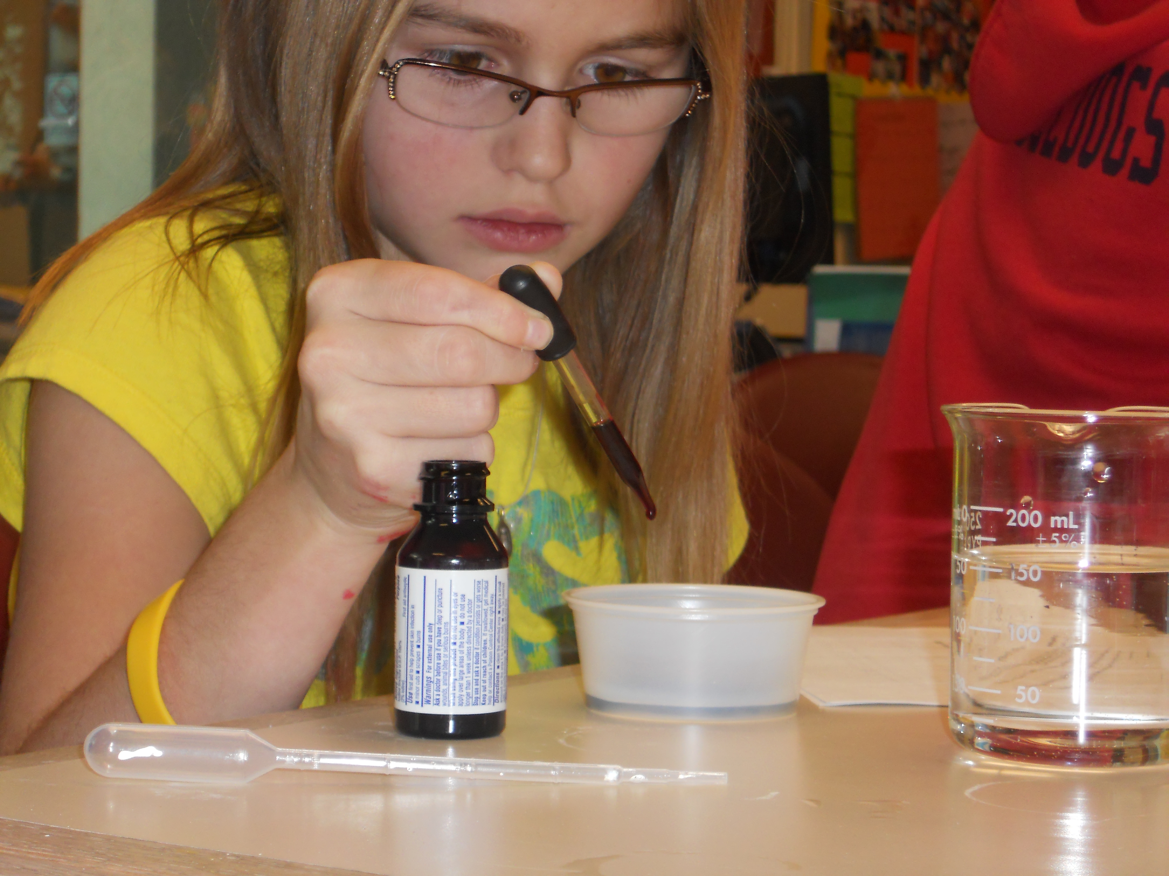
Restrictions on Laboratory Materials
NO:
Biological Materials
Sharps (Needles, Knives)
Chemicals
Open Flames

Slide 7
Educational Barriers
Differential levels of previous classroom education and interest
Lack of instructor knowledge
Lack of resources to conduct labs
Interrupted learning due to medical conditions

Slide 8
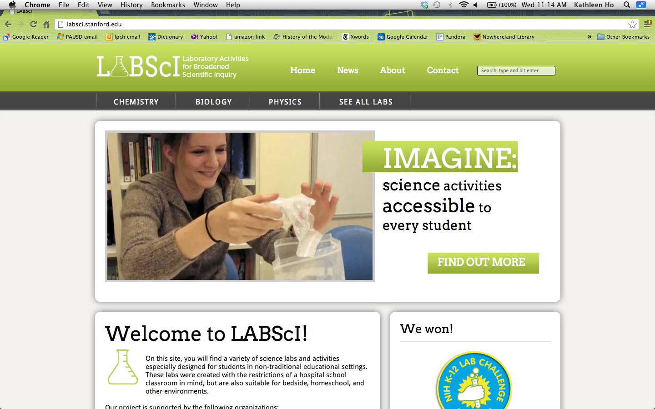
WWW.LABSCI.STANFORD.EDU
Notes:
We have basic and advanced level labs.
Members of the LABScI program have developed science laboratory activities under the overarching themes of biology, chemistry, and physics. This volunteer-run program aims to provide high-quality, hands-on science education for the students with medical and hospital restrictions.

Slide 9
Content Covered
Labs fulfill the California State Board of Education’s Content Standards (K-12)
Integrative Labs Under Development
Biology Labs
Cell Biology
Genetics
Ecology
Evolution
Physiology
Chemistry Labs
Atomic & Molecular Structure
Chemical Bonds
Conservation of Matter & Stoichiometry
Gases
Acids & Bases
Solutions
Chemical Thermodynamics
Reaction Rates
Chemical Equilibrium
Organic Chemistry and Biochemistry
Nuclear Processes
Physics Labs
Motions & Forces
Conservation of Energy & Momentum
Heat & Thermodynamics
Waves
Electric and Magnetic Phenomena
Design Thinking
Rube Goldberg Simple Machines
Disease Transmission & Immunology
Earth Sciences
Biology Labs
Cell Biology
Genetics
Ecology
Evolution
Physiology
Integrative Labs Under Development
Design Thinking
Rube Goldberg Simple Machines
Disease Transmission & Immunology
Earth Sciences

Slide 10
Long-Term Program Goals
Sustainability of labs and lessons
Adjustable content for grades 5-12
Adaptable for one-on-one learning environment or full classroom
Suitable for hospital, home school, or other educational settings
Teachable by individual of any educational background
OPEN ACCESS TO EDUCATION
Notes:
And, here’s where you all come in. I presented this at
Design Thinking
Rube Goldberg Simple Machines
Disease Transmission & Immunology
Earth Sciences
If you have any ideas at all, I would love to connect with you after this presentation

Slide 11
Who wants to build some rollercoasters?

Slide 12
Some Participating Hospitals & Programs
Lucile Packard Children’s Hospital School (Stanford, CA)
Legacy Emanuel Children’s Hospital (Portland, OR)
Nationwide Children’s Hospital (Columbus, OH)
Sanford Children’s Hospital (Sioux Falls, SD)
St. Luke’s Children’s Hospital (Boise, ID)
Durham Public School’s Hospital School at Duke (Durham, NC)

Slide 13
Acknowledgments
Lucile Packard Children’s Hospital School
Hospital School Teachers & Volunteers
Spakowitz Lab, Department of Chemical Engineering
Professor Robert Siegel, Sage Mentor
Sage Bionetworks & Paris Assembly
Program in Human Biology

Slide 14
Thanks for listening!

Slide 15
Questions? Ideas? Interested in using LABScI content?
Please contact me at: nhdalal@stanford.edu
I would love to hear from you!

