Slide 1
Patients as researchers: accelerating innovation in food and health beyond the evidence based paradigm
Dr. Ir. Gaston Remmers
Patient Advocate, Inspire2Live
Co-founder, Platform Patients and Food Netherlands
Director, HABITUS | enabling healthy habitat development
(g.remmers@habitus.nu)
Commons Assembly: bridging divides
SAGE post Paris Assembly
September 19th 2015, Stanford University
Notes:
Gaston Remmers, Inspire2Live, Netherlands

Slide 2
This presentation
Who am I - the urge for reducing incidence
The end of Pubic Health, the end of statistical certainty
Food as an example: short video
The collaborative triangle of Personalised Food
Patient Movement on Food
Stepping stones
Patient Experimentation
Food Coalitions - Prostate cancer

Slide 3
Prevention & Reducing Incidence…
….. are largely the area of Public Health: common, consensuated, generalizable knowledge in the area of food(safety), air pollution, etc
….. based on statistical truths based on large numbers of research: “evidence based”.
Formula based: “when this, (nearly) always that happens”
Works well …. to a certain level

Slide 4
Let’s consider Food
Tremendous public debate on food and health
Almost invariably wrapped up in inextricable wars on claims, leading to more in-depth research, trying to identify hard causal relations
The question:
Yes and No
Yes, it certainly adds to your health
No, works completely different, as a multiple drug targeting multiple goals, ‘covering’ the body in a fine mist of substances
So why research food as if it is medicine?
Plus: Public Health says: “Eat more vegetables and fresh food”. But it is not enough as a message; product quality should rise too... -> paradox: more stress, better food
Is Food a Medicine?

Slide 5
What do we eat: caterpillars or butterflies?
How can we make sure we eat food that certainly adds to our health? That I eat food for My Health?
→ Project on Personalised Food

Slide 6
Appraisal ‘Business Potential of Personalised Food’(2014)

Slide 7
The challenges of Personalised Food in a Nutshell
https://www.youtube.com/watch?v=Vt3PS5NW96g

Slide 8
Multistakeholder challenge - Questions to be resolved…
Patients
Does your product contain what you claim?
Do you want to collaborate in our research?
Is your diagnosis reliable?
Biomedical
Research/ Care
Will you buy my product?
Horti-culture
Can you grow food with demonstrated health effects?
Do you give food the position in health care it deserves?

Slide 9
What is common?
UNCERTAINTY
…Patients are most experienced with dealing with uncertainty…

Slide 10
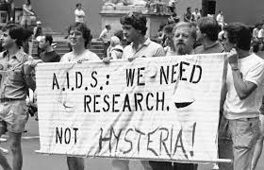
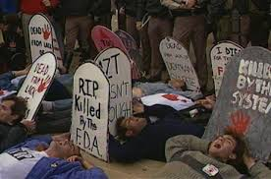
Patients say: Get a life!

Slide 11
Patient Movement on Food

Slide 12
100.000 new cancer patients each year in Netherlands
50 % uses food supplements or alternative food habits
(Meijer et al, 2004)
Own questionnaire:
2/3 experiments with food, ¾ willing to donate DNA for R&D in Pers Food (n=288)
Unease not only applies to the intake of different food, but also reveals a search for different perspectives on the link between food and health (e.g. ayurveda)

Slide 13
European Patient agenda
2013:
Agenda developed by two patient groups:
European Patients Forum (EPF) and European Genetic Alliance Network (EGAN),
with a professional (para-)medical network
European Nutrition for Health Alliance (ENHA)
Valuable kick-off, yet little focus as of yet on role of fresh food and prevention

Slide 14
Dutch Patient agenda
Builds on the 2013 report and expands it
Key points:
Actors in food and health system to collaborate in order to empower food to become an acknowledged medical prevention and intervention strategy, tuned to the stage in the treatment process and the phase of life one is in
Recovery and care after treatments
Unborn child
End of life
Prevention

Slide 15
Dutch Patient Agenda (2)
Better (early) diagnostics , incl DNA
Build on experience based knowledge of patients
Take serious and validate alternative visions on food and health
Better dietary advice
Food research to focus on synergistic health effects of food
Better food products
“Salutogenic society” : healing environments at all levels
Build up of patient movement
Roadmap for the development of Personalised Food from a patient perspective (Platform Patient and Food)

Slide 16
Dutch Patient agenda (3)
Platform Patient and Food – currently involved organisations
Cancer: Inspire2Live, Levenmet Kanker
Kidney patient organisation
Heart & Vessels groups
Obesity organisation
Diabetes Lung patients organisation
ME/Chronic Fatigue Syndrome
Muscle disease organisation
Dutch CAA Foundation
VSOP rare and genetic illnesses organisation

Slide 17
Working towards transitions: Stepping Stones
Patient experimentation on food and health
Food coalitions

Slide 18
Patient experimentation on food and health
Goal: to establish a trusted platform
Challenges:
How to extract knowledge from highly contextualised data?
Widen the methodological research scope, beyond (and before…) RCT’s:
Qualitative Narrative research techniques, story analysis, combined with hard data (QS)
Grounded theory – no virtual patients
Uncertainty is a given, learning based paradigm
Learn from other domains: agriculture, spatial planning
Eventually: Health Data Cooperatives – ownership is crucial

Slide 19
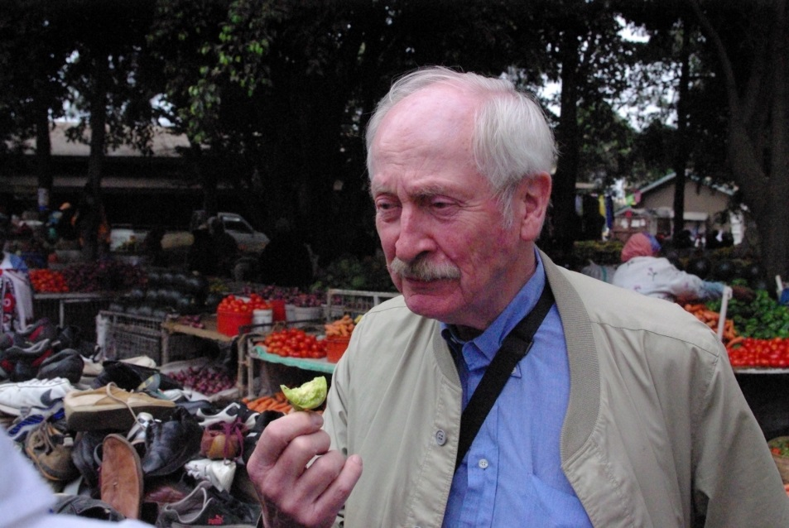
Food coalitions
Foodsupplement Prostate Cancer - PROSTAPREV
O.a. Vit E, lycopene (tomatoes), soy isoflavonoids
Doubling time of PSA levels delayed with factor 2.6
Research dates back to 2005 (Schröder)
Even patented, but not on the market
Thru patient involvement:
Coordinating group established
Now available, plus follow-up
Financial feedback mechanism

Slide 20
Voedingssupplement Prostaprev
Pranayur supports the Foundation for Scientific Research on Prostate Cancer (SWOP). Of all sold packages € 1,- is donated to SWOP.

Slide 21
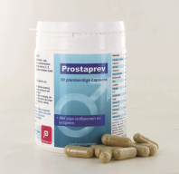
Dynamism Foodsupplement Prostate Cancer
Research
Research group Erasmus MC + Numico /Danone
2005
Working recipe for
foodsupplement
Elaborate diet /
Foodpattern
(incl patients views)
2014
Coordinating Group established
Appraisal Personalised
Food
Production
Ars Pro Pharma
Sales
Holisan
2016
2015
Pilot
“I chose my Food for
My Health”
Community build up
Additional research
Coordinating committe
Research group Erasmus MC
Broadend coalition
PC Patients – I2L /
PC Foundation
Urologists
Oncologist
Phase 4
Are results replicable?
100 patients
intense coaching programme by food experts
Home delivery of specialised food
Scientific monitoring of PROM’s
Innovation process
Experim. Research w. mice
Which compounds are active?

Slide 22
Coordinating Group
Foodsupplement Prostate Cancer - PROSTAPREV
Rotterdam Erasmus Medical Centre
(prostaat) Kankerpatienten (Inspire2Live, PC Foundation)
Holisan / Ars ProPharma (sales / production)
Pilot ‘I choose my Food for My Health’
Horticultural producers Westland production area
Municipality Rotterdam
….

Slide 23
So, what can you build on?
UNCERTAINTY
CO-CREATION
PATIENTS

Slide 24
Thank you!
Contact:
Gaston Remmers
M: + 31 – 6 41 37 41 02
E g.remmers@habitus.nu
www.habitus.nu
www.inspire2live.org
www.patientenvoeding.nl

Slide 25
Why Personalised Food?

Slide 26
“I AM AGAINST EQUAL TREATMENT”

Slide 27
Dutch Cancer Research Institute / AvL medical Centre
Dutch Cancer Fund
“I AM AGAINST EQUAL TREATMENTS”

Slide 28
ALL HUMAN BEINGS ARE UNIQUE
ALL TUMORS TOO
AND SO IS THE FOOD THAT IS FIT FOR SOMEBODY
Notes:
Laten we weer luisteren naar onze biologie. DNA is daar een belangrijke bron van – maar niet de enige

Slide 29
How does this ‘uniqueness’ of food relate to other food concerns?

Slide 30
Personalised & Common Food
5 –20 yrs
SPECIFIC healthier eating / living:
Food exactly tuned to the individual citizen / patient, diverging from general guidelines
Biomedical sector (research)
Quality and effectivity of CF strengthened by PF
PERSONALISED FOOD
Agricultural sector
Patients / citizens
COMMON FOOD
GENERIC healthier eating / living:
more fruit, vegetables and fresh products, less sugar / meat / salt/ fat, more physical exercise etc
Broadly defined care ’sector’: hospitals, home for the elderly, public health authorities (GGD), corporations, schools, sports clubs, etc
PF dwells on broad public interest in CF: health supporting food, urban farming etc.
0 – 5 yrs
Notes:
Stadslanbouw enz

Slide 31
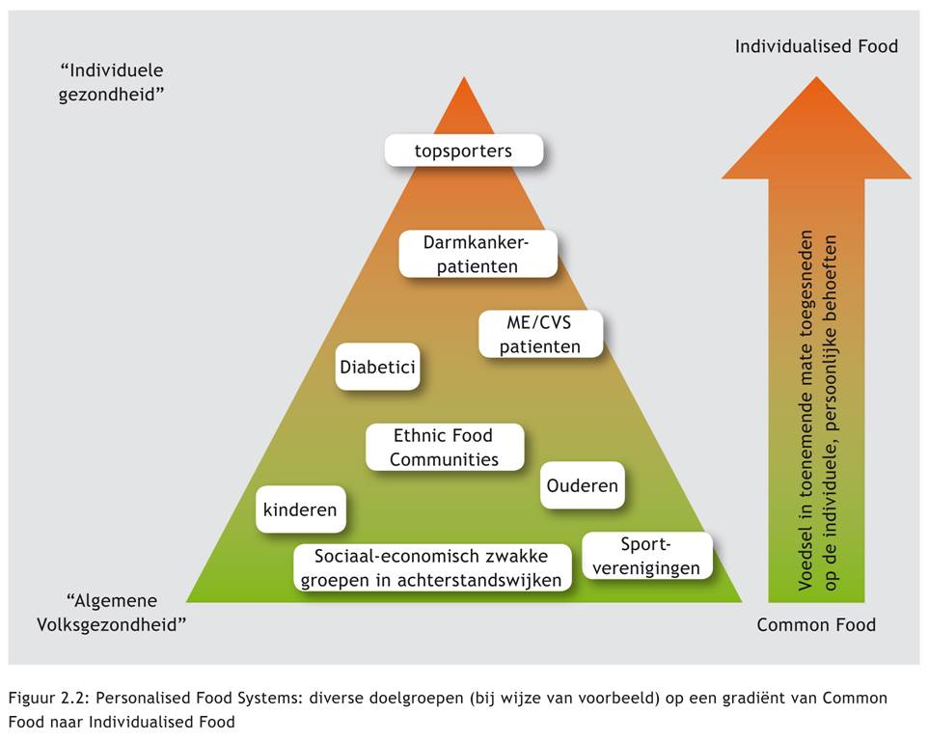

Slide 32
Personalised Food Systems
“Individual Health”
Individualised Food
Increased Personalisation of Food
Elite athletes
Cancer colon patients
ME/CFS patients
Diabetics
Ethnic Food
Elderly
children
Lower income groups in urban suburbs
“Public Health”
Sport clubs
Common Food

