Slide 1
Bi Curious
Eri Gentry
Co-founder & President, BioCurious
Research er, Institute for the Future (IFTF)
eri@biocurious.org
@erigentry

Slide 2
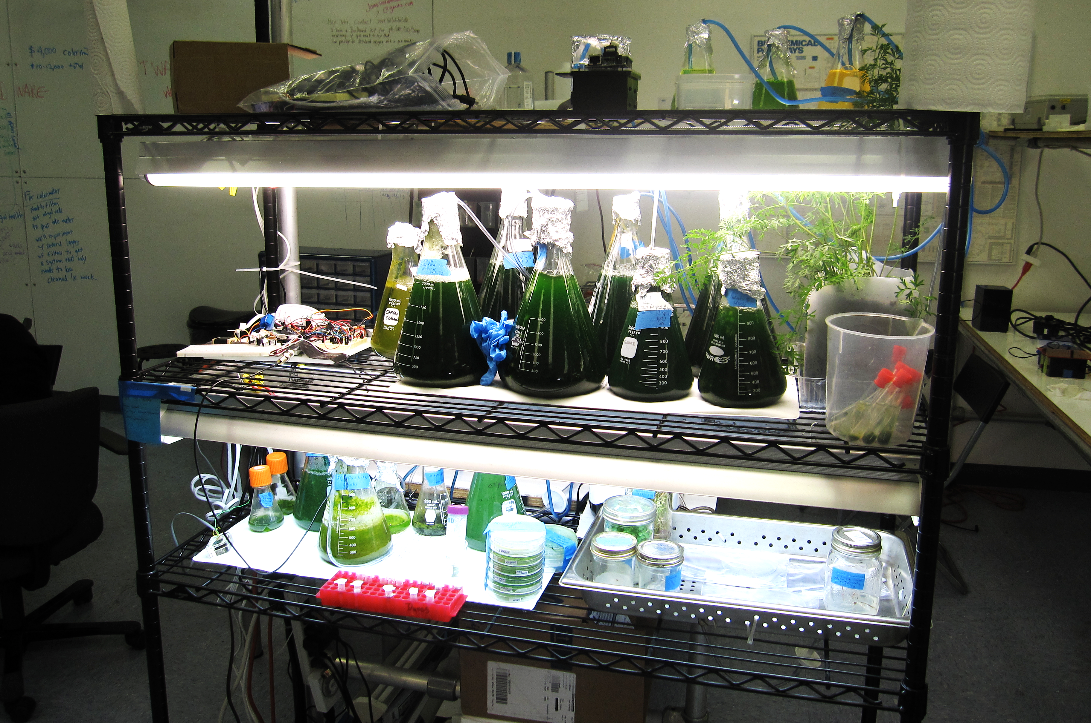
COMMUNITY LABS: A PRIMER

Slide 3
LAB + COMMUNITY
Community labs provide
  Space (benches, storage…)
  Equipment (maintenance)
  Biohazardous waste removal
  Training (safety, equipment…)
  Classes (biology of the cell, how to build a PCR machine)
  Networking
  Co-working

Slide 4
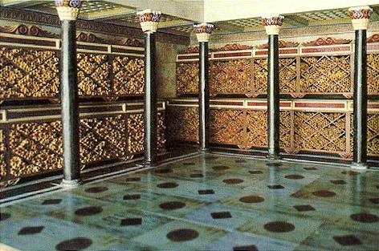
Library of Alexandria
circa 300 BC
Notes:
WHY?

Slide 5
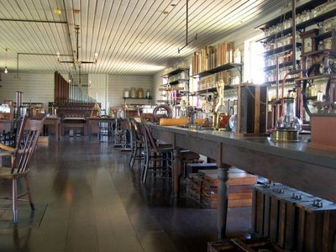
Thomas Edison Machine Shop
Circa 1880

Slide 6
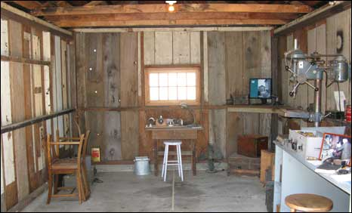
Hewlett and Packard’s
Garage in Palo Alto
Circa 1938

Slide 7
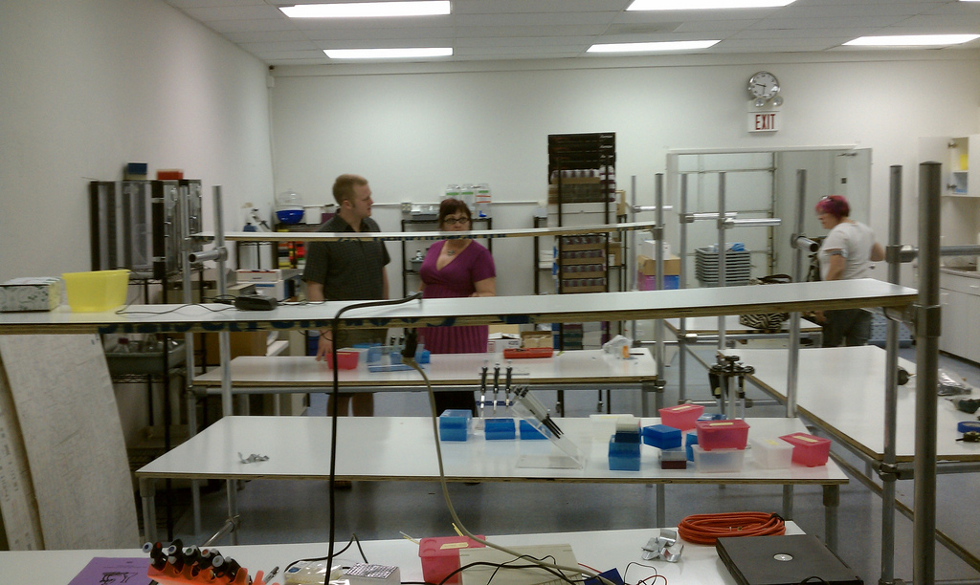
BioCurious
2011

Slide 8
Opportunity space
Industry
Higher education
Research
Everyone else

Slide 9
Proof of concept?
Publish
Funding – VC, Grants
Now:
community labs, crowdfunding
Idea?
In academia or industry?
Check with PI/advisors/mgmt.
Not in academia or industry?
community labs
Curious?
Keep looking for a job
community labs
Internet
community labs
PhD out of work?
Go back to school
Incubation

Slide 10
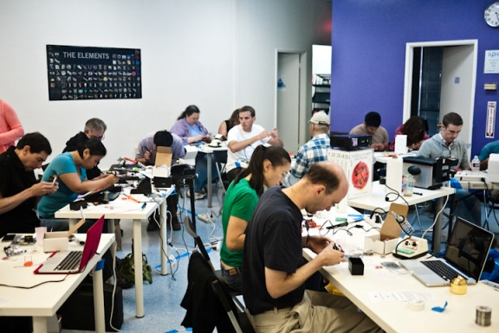
BIOCURIOUS?
Experiment with Friends.

Slide 11
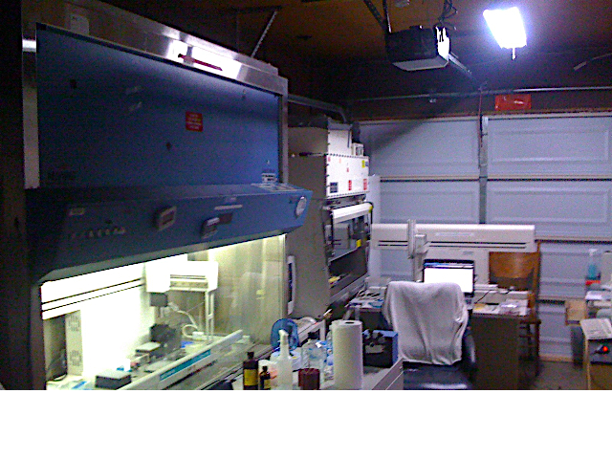
Notes:
That started in a garage

Slide 12
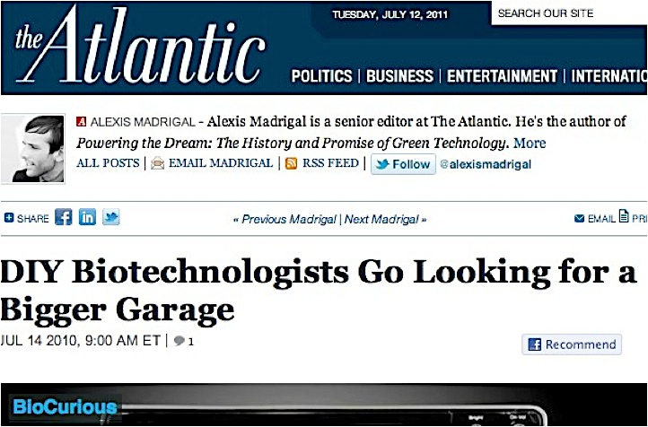

Slide 13
Timeline
2009 – BioCurious launches out of a garage
2010 – BioCurious becomes one of the first projects on Kickstarter
2011 – BioCurious, a the community lab and hackerspace for biotech opens
2012 – 3D Bioprinter and Bioluminescence projects begin
2013 – BioCurious’ President named White House Champion of Change
2014 – BioCurious named 4th Most Innovative Company in the World in Education by FastCompany

Slide 14
What is BioCurious?
A hackerspace for biotech
1st and largest biohacker lab in the world
The largest local “extra-institutional” community in the world
501c3 non-profit organization, volunteer-run, and committed to making biology accessible, affordable, and open to everyone
A community lab built for and supported by members
A place to “experiment with friends”

Slide 15
Mission statement
We believe that innovations in biology should be accessible, affordable, and open to everyone.
We’re building a community biology lab for amateurs, inventors, entrepreneurs, and anyone who wants to experiment with friends.

Slide 16
We Care About
Democratization of technology
Education and (re)training
Community outreach
Growing a community of early – and late – adopters
Exploring opportunities created by access to biotech tools & training

Slide 17
What we do
Provide lab space and shared equipment
Host classes, meetings, community events and projects
Provide education – lecture & hands-on lab courses
Membership = $100 per month
  OR Pay $1000 for a year (2 months free!)
Open 7 days a week, staffed on a completely volunteer basis
  BioCurious demands no IP or equity from
  lab space users

Slide 18
Who we are
Founders (6) – all non-traditional scientists, all entrepreneurs who struggled to gain access to biotech
Members (70)
  Engineers – Software, Mechanical, Chemical, Materials
  Scientists – Plant biologists, Biochemists, Physicists, (yes, even a Rocket Scientist)
  Artists & Musicians
  High school students
  Entrepreneurs – Looking for the next big thing
Volunteers (40)
  Students
  Recent grads
  Retired scientists
  Scientists looking for work
Local community (2300)
  All of the above and everything in between. They have all loved science at some point in their lives.

Slide 19
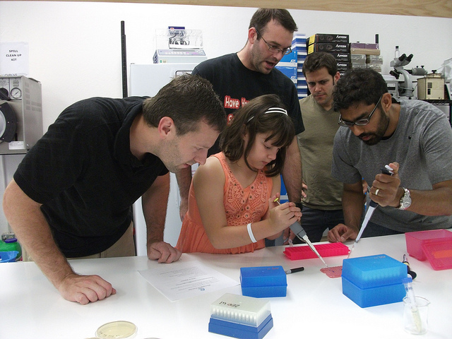
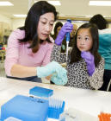
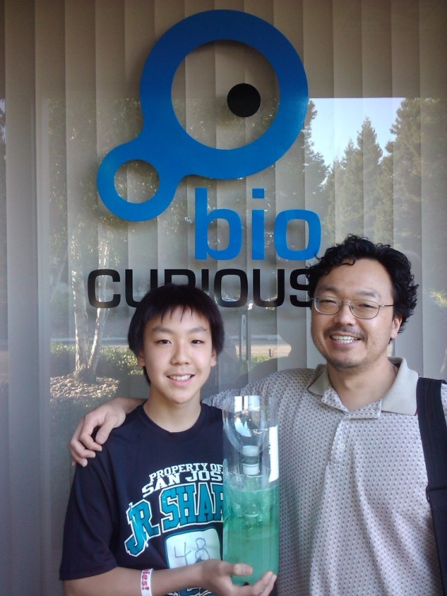

Slide 20
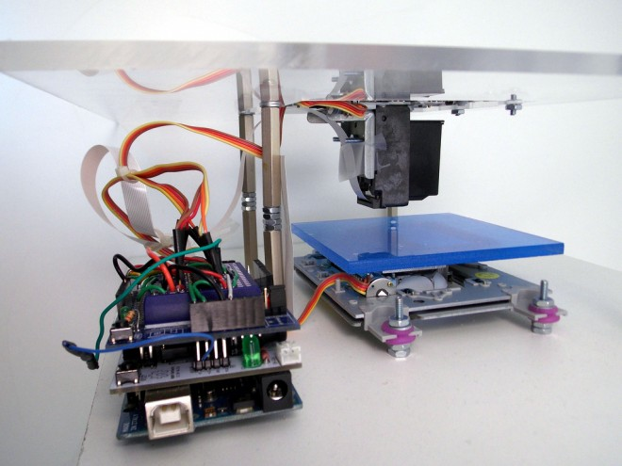
Projects
In addition to membership, we offer free & open community projects (BioPrinter & Bioluminescence)
Members may start any project that complies with safety regulations
  Members supply their own reagents
May sponsor a project
  iGEM – Real Vegan Cheese

Slide 21
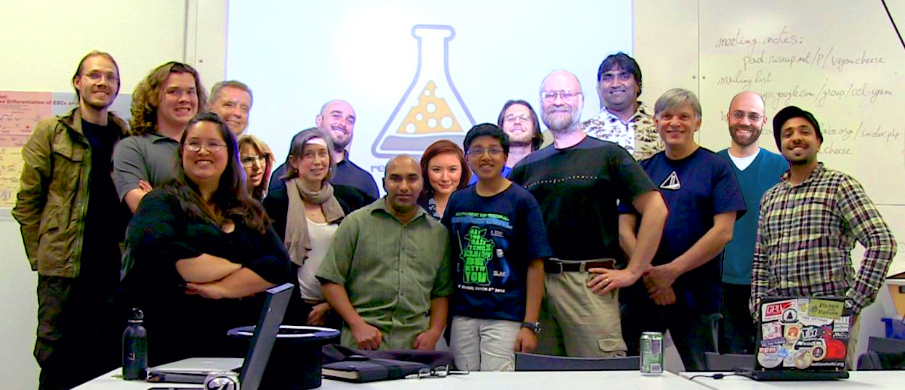
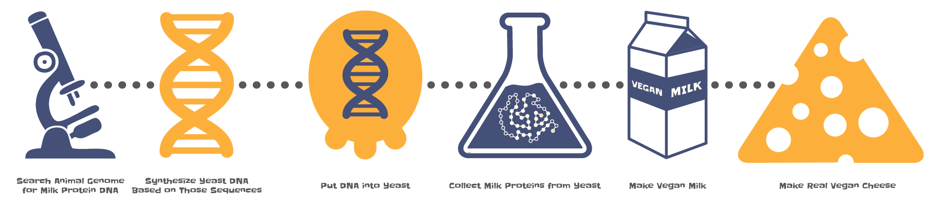
Case study: Real Vegan Cheese
Creating a more ethically sourced cheese
Conducting a study of environmental and economic impacts of ruminate cheese vs. vegan cheese
Filing a patent, which they intend to release to the public domain

Slide 22
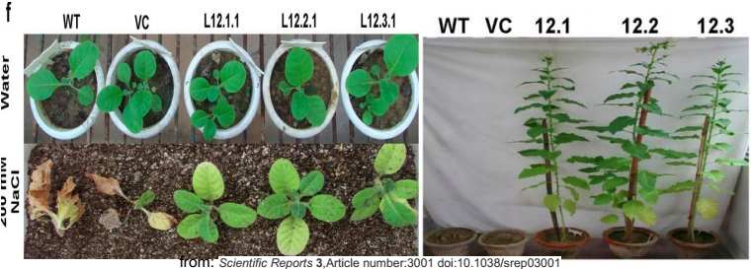
Case study: Bharat Farms
Software engineer wants to grow crops in India → farmland barren
Moves to Sunnyvale. Looks for bioengineered solution
Finds plant biologist mentor. Creates proof of concept
Hires current members, finds new member-employees, recruits teenage daughter

Slide 23
Safety Guidelines
Self regulated as a BSL1 facility (well-characterized agents). No release of genetically modified organisms
Volunteer safety team – professional & retired scientists, recent grads, self-taught scientists
  Created safety manual
  Reviews projects
  Oversees equipment, consumables, reagents, upkeep
Anyone over 18 may be a member
  Anyone under 18 must be accompanied by a parent/guardian
All members and volunteers must go through (free) orientation and safety training. Must pass online safety quiz
  Policies reviewed with each new project

Slide 24
What we are protecting
At BioCurious, we are concerned about protecting the safety of members and guests using our facility, the community in which we reside, the environment in which we live, and our own continued ability to operate a biohackerspace. We believe we have an obligation to these four groups, and as a member of BioCurious, so must you.

Slide 25
Guiding Principles
Open access
Bottoms up research & organizational design
Diversity across participants and experiments
Safety for members, community, environment and ability to experiment
Transparency
Community & collaboration (mentorship & teamwork)

Slide 26








Workshops

Slide 27
Visit us!

