Slide 1
RARE / ORPHAN DISEASES
“ARE WE READY FOR THE CHANGE THAT WE NEED TO FIND EFFECTIVE TREATMENTS FOR ORPHAN DISEASE?”

Slide 2
YES!
Rare disease is very ‘popular’!
Rare disease <200,000 Americans have disease
7,000 different types of rare diseases and disorders
30 million people in the U.S. (10% of population)
Europe has approx 30 million rare disease cases as well

Slide 3
FDA Encourages…
FDA launched the Orphan Drug Act (ODA) in 1983 to create incentives for pharma/biotech to invest in rare disease
Major benefits including:
— Funding for clinical testing
— Tax credits
— Assistance in clinical study designs
— 7-year period of exclusive marketing after approval
— Waiver of Prescription Drug User Fee Act (PDUFA) filing fees

Slide 4
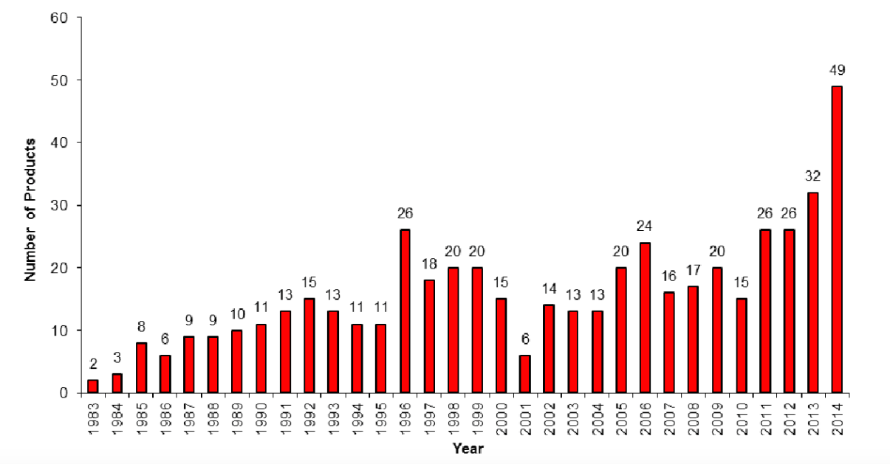
ODA has changed the drug approval landscape for orphan disease!

Slide 5
CDER for innovation…
New regulatory pathways to help speed up drug development
— Fast track - increased communication with FDA
— Breakthrough – FDA serious guidance
— Priority review- reduce FDA review time by half
— Accelerated approval- surrogate endpoint based
CDER=Center for Drug Evaluation and Research

Slide 6
Rare disease benefits from CDER innovation

Slide 7
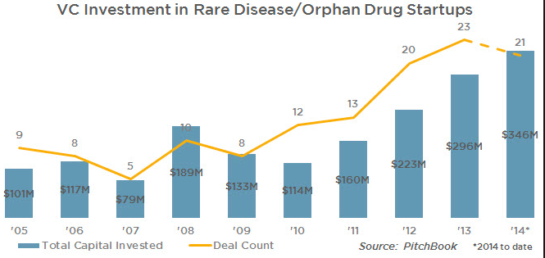
Rare disease popular in VC space
http://blog.pitchbook.com/

Slide 8
BUT-
Typical roadblocks in R&D…
even more visible in rare disease sector

Slide 9
Roadblocks for Patients
Patients misdiagnosed & undereducated
Lack of knowledge around patient needs
Limited access to clinical trial info & sites
Roadblocks for Researchers & Industry
Tissue is very scarce
Small often ill-defined patient population- lack of validated endpoints
Market unknown
Lack of tools (cells, animal models) & data
Lack of researchers & collaboration – Slow/inefficient

Slide 10
FIXABLE?
Yes, but…need for change
Success stories of Children’s Tumor Foundation

Slide 11
Children’s Tumor Foundation (CTF)?
501(c)3 medical foundation
Focused on rare disorder: neurofibromatosis NF
— Family of autosomal dominant genetic disorders-NF1, NF2, schwannomatosis
— Tumors grow on nerves, learning disabilities, deafness, blindness,
cancer, pain etc.
CTF philosophy: change to fix the roadblocks – use innovation, creative business model

Slide 12
CTF solutions for Patients
Roadblocks for Patients
Patients misdiagnosed & undereducated
Lack of knowledge around patient needs
Limited access to clinical trial info & sites
NF Clinic Network / NF Forum / educational materials
Volunteer Leadership Council very involved
NF Registry

Slide 13
CTF for Researchers & Industry
Roadblocks for Researchers & Industry
Tissue is very scarce
Small often ill-defined population-lack of validated endpoints
Market unknown
CTF Open Biobank
CTF funds endpoint development
Market model developed
Lack of tools (tissue, cells, animal models) & data
Lack of researchers & collaboration – Slow/ inefficient

Slide 14
Success story 1: Lack of tissue, tools & data
Patient wants to donate body to NF
Patient: gives consent to CTF & donates blood
Biobank: prepares kits
NDRI: informed of new patients
CTF: keeps in touch with patient
1
2
Family/ friend contacts NDRI when patient passes
Body recovery and tissue collection by NDRI.
Tissue to pathologist for NF confirmation
3B
Tissue to lab for cell line generation
3A
OPEN DATA
@ SAGE
Tissue to biobank, tissue analysis center
CELL LINES FOR ALL
4
Data to Sage/ Analysis
5

Slide 15
Success story 2: CTF consortia science
Goal:
Accelerate path from basic discovery to clinical benefit
Increasing understanding by sharing failures
Make all data public
Break the walls between artificially divided research categories (clinical, translational, basic,..)
Centralize data management/ analysis

Slide 16
NF Preclinical Consortium
— 4 academic centers -- NF1 animal models –
testing drugs in parallel in multiple models
—Unpublished data gets discussed
—Clinicians involved
MEKi from target POC testing in NFPC to first clinical trial in < 3 years!

Slide 17
Synodos- collaborative accelerator
Characteristic | Why accelerator?
Dream team of diverse experts | No delay (mis) interpreting other scientists data sets Learn from each other
Data shared with world after 12 months | No need to wait for publications to come out Sense of urgency in team to publish data quickly
Negative data shared | No money/ time wasted refunding same failures Learn from failures
Milestone driven projects | All experiments aligned – industry quality planning

Slide 18
Synodos for NF2
12 academic centers; mix of all expertises
In less than 12 months:
— From unknown screening pipeline to well-defined screening system
— All in vitro screens finalized – undergoing in vivo testing now
— Efficacious combinations identified using transcriptomics & kinome analysis
— All data centralized at Sage Bionetworks

Slide 19
Thanks to our team mates:
Sage Bionetworks team
Synodos team
NFPC team
NTAP
CTF team

